Slide 1
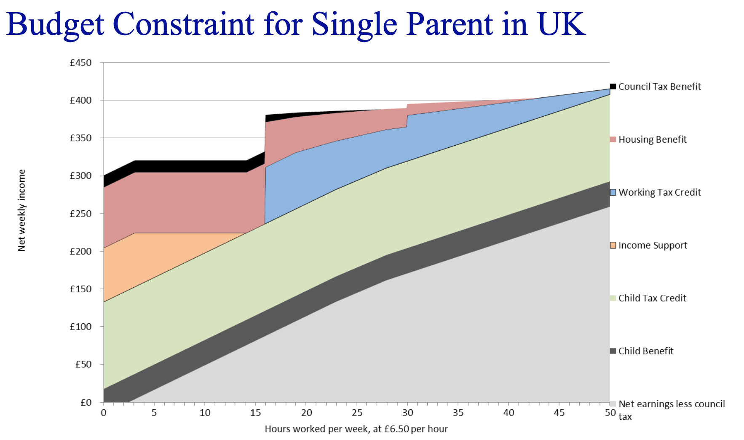
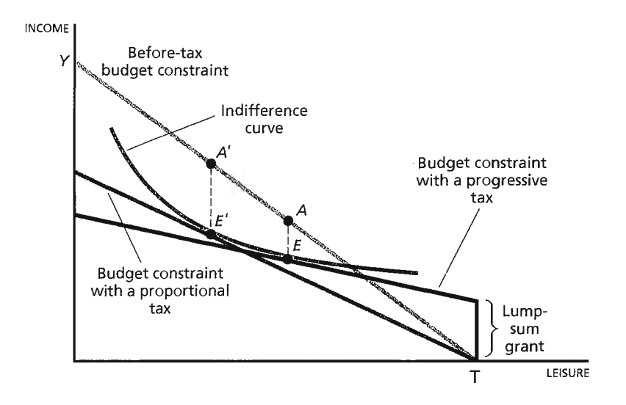
Weeks 1-3
EC4415: Public Economics
Land rent, Tariffs vs Quotas, Welfare, DWL

Slide 2
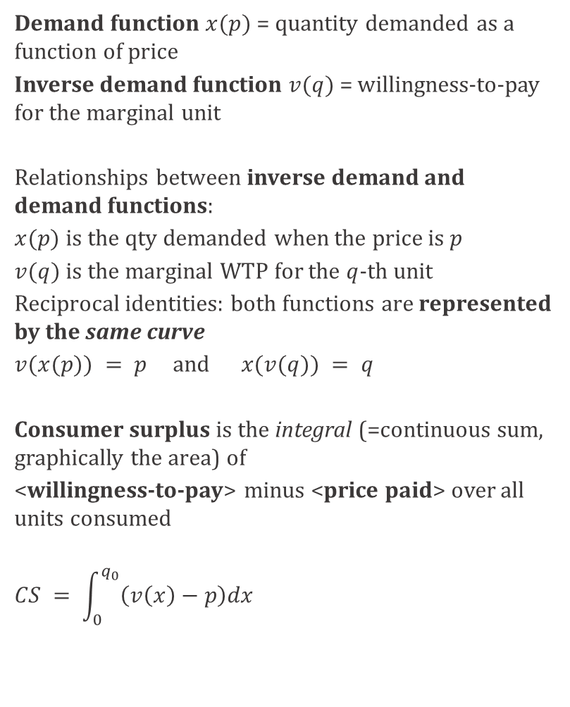
Demand curves and consumer surplus
Demand function $x(p)$= quantity demanded as a function of price
Inverse demand function $v(q)$= willingness-to-pay for the marginal unit
Relationships between inverse demand and demand functions:
$x(p)$is the qty demanded when the price is $p$
$v(q)$is the marginal WTP for the $q$-th unit
Reciprocal identities: both functions are represented by the same curve
$v(x(p)) = p$ and $x(v(q)) = q$
Consumer surplus is the integral (=continuous sum, graphically the area) of
<willingness-to-pay> minus <price paid> over all units consumed
$$CS = \int_{0}^{q_{0}}{\left(v\left(x\right)−p\right)dx }$$

Slide 3
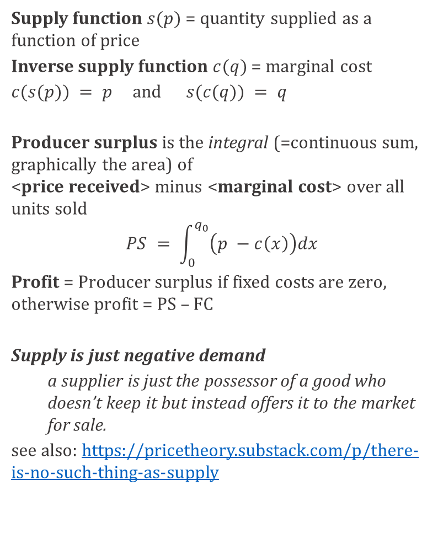
Supply curves and producer surplus
Supply function $s(p)$= quantity supplied as a function of price
Inverse supply function $c(q)$= marginal cost
$c(s(p)) = p$ and $s(c(q)) = q$
Producer surplus is the integral (=continuous sum, graphically the area) of
<price received> minus <marginal cost> over all units sold
$$PS = \int_{0}^{q_{0}}{\left(p −c\left(x\right)\right)dx }$$
Profit = Producer surplus if fixed costs are zero, otherwise profit = PS – FC
Supply is just negative demand
    a supplier is just the possessor of a good who doesn’t keep it but instead offers it to the market for sale.
see also: https://pricetheory.substack.com/p/there-is-no-such-thing-as-supply

Slide 4
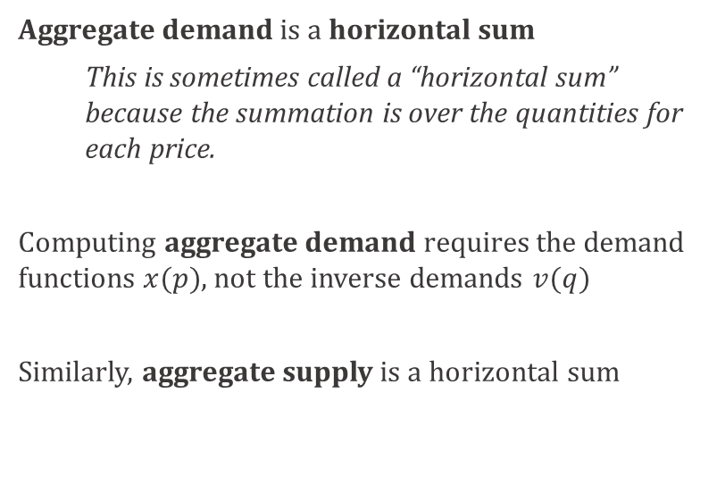


Demand aggregation
Aggregate demand is a horizontal sum
    This is sometimes called a “horizontal sum” because the summation is over the quantities for each price.
Computing aggregate demand requires the demand functions $x(p)$, not the inverse demands $v(q)$
Similarly, aggregate supply is a horizontal sum
$$v_{L}\left(q\right)= 64 – 2q$$
$$v_{R}\left(q\right)= 48−1.5 q$$
Reference: McAfee’s open-source textbook Introduction to Economic Analysis,
or just look up <your Intermediate Micro textbook>
https://www.dropbox.com/scl/fi/vwnsfzxkdgu6o4vlvkg1h/McAfee-IEA-ch2-ch3-Supply-Demand-Quantification.pdf?rlkey=9gw2qt5ml53zyi3ttxnjslltn&dl=0
https://www.dropbox.com/scl/fi/89t2x0vx05rf7fphwc3g7/McAfee-IEA-ch5-Government-Interventions.pdf?rlkey=ykuxroherif1toc37i955hwas&dl=0

Slide 5
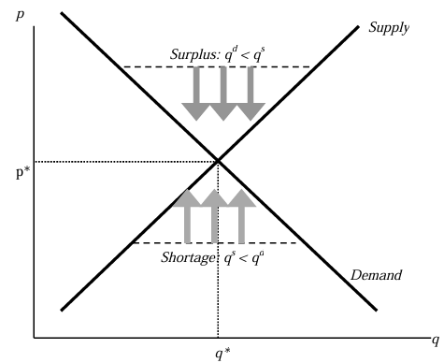
Disequilibrium and market prices
In Figure 2.4.1, a surplus arises at any price above the equilibrium price because the quantity supplied is larger than the quantity demanded. The effect of the surplus – leading to sellers with excess inventory – induces price cutting which is illustrated with three arrows pointing down. Similarly, when the price is below the equilibrium price, the quantity supplied is less than the quantity demanded. This causes some buyers to fail to find goods, leading to higher asking prices and higher bid prices by buyers. The tendency for the price to rise is illustrated with the arrows pointing up. The only price which doesn’t lead to price changes is, the equilibrium price in which the quantity supplied equals the quantity demanded.
McAfee IEA ch2 ch3 - Supply, Demand, Quantification
There are two ways that people tend to discuss disequilibrium. The first is to focus on price. If the price is “too high” (above the equilibrium price), there will be excess supply. Sellers will therefore tend to lower the price of their product. If the price is “too low” (below the equilibrium price), there is excess demand. Buyers will tend to bid up the price toward the equilibrium price.
The second approach is to focus on quantity. Start with a quantity that is “too low” (the quantity is below the equilibrium quantity). At this quantity the willingness to pay for another unit of the good is greater than the marginal cost of producing the good. There are gains from trade to be had. Thus, the quantity will increase toward the equilibrium quantity.
https://www.economicforces.xyz/p/those-pesky-transaction-costs
Notes:
SKIP

Slide 6
First Theorem of Welfare Economics
There are circumstances where the equilibrium level of trade has harmful consequences, and such circumstances are considered in the chapter on externalities. However, provided that the only people affected by a transaction are the buyer and seller,
the competitive equilibrium allocation maximises total gains from trade (=total surplus)
the highest value buyers must get the goods
the lowest cost sellers must supply those goods.
how many goods should be traded to maximize the gains from trade?
  - Adding a trade increases the total gains from trade iff that trade involves a buyer with valuation higher than the seller’s cost. Thus, the gains from trade are maximized by the set of transactions to the left of the equilibrium quantity, with the high-valuation buyers buying from the low-cost sellers.
McAfee IEA ch2 ch3 - Supply, Demand, Quantification

Slide 7
First Theorem of Welfare Economics
FTWE: the competitive equilibrium allocation maximises the total gains from trade
The FTWE involves market prices
Consumers should all face the same prices
Producers should all face the same prices
Consumers and Producers should face the same prices (this fails if there is commodity taxation)
Prices combine a signal (transmit information) and an incentive to respond to that information.
For prices to feed “cleanly” into decisions requires competitive behaviour: no market power
either for Producers (monopoly - oligopoly)
or for Consumers (monopsony).
Competition without prices does not usually promote social welfare (e.g. gang wars, competition between species for an ecosystem niche, competition within species for mates). Prices are unique in inducing competing market participants to take socially optimal decisions even though none of the market participants cares about social optimality.
McAfee IEA ch2 ch3 - Supply, Demand, Quantification

Slide 8
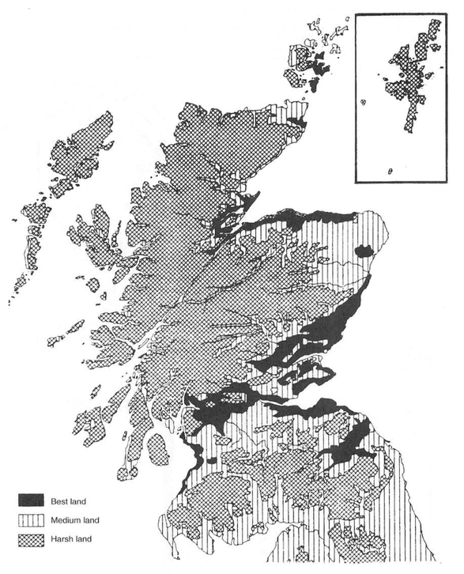
Land rent and international trade
scotlandsplaces.gov.uk/digital-volumes/published-gazetteers-and-atlases/atlas-scottish-history-1707/atlas-scottish-history-1707/37
This map of 1707 Scotland distinguishes between three categories of land available for cultivation: best (flat, large fields), medium, and harsh (upland moors). Historians often quantify land quality through subsistence potential, that is, the cost of producing a given amount of food.
We model a closed economy where land is used to produce food. We distinguish three categories of land as on the 1707 map, but land is heterogeneous both between categories and within each category.
Fertile (best) land produces food at the lowest marginal cost, up to a maximum of 1455 units. Medium land produces food at the next-lowest marginal cost, up to a maximum of 1328 units. Harsh land produces food at a still higher marginal cost, up to a maximum of 939 units.

Slide 9
Medium land produces food at the next-lowest marginal cost, up to a maximum of 1328 units.
Fertile (best) land produces food at the lowest marginal cost, up to a maximum of 1455 units.

Slide 10
Aggregate supply of F & M

Slide 11
Harsh land produces food at a still higher marginal cost, up to a maximum of 939 units.
Aggregate supply
Aggregate supply of F & M

Slide 13
FT1 features
Free-Trade equilibrium FT1
Consumption efficiency: all 4810 units are allocated to consumers with WTP 100 or greater;
Production efficiency: domestic production takes place on plots with marginal cost below 100; remaining units are imported at an effective domestic marginal cost of 100.
Efficient quantity: All transactions capable of generating positive surplus take place.
First Theorem of Welfare Economics: competitive equilibrium FT1 achieves the maximum total surplus.

Slide 14
Opening up trade, A1 to FT1: Welfare, transfers
Relative to autarky, when opening trade (A1 to FT1),
- consumer surplus rises
- producer surplus falls
Opening trade is not a Pareto improvement.
Total economic surplus rises. Therefore, the winners (consumers) could compensate the losers (producers) and still come out ahead:
Opening trade is a Kaldor-Hicks improvement,
Kaldor-Hicks compensation is hypothetical.
Compensatory transfers are not common in modern politics. Coalitional bargains (bundling legislation on opening up trade with another legislation benefiting producers) and complex international agreements (e.g. deals involving a mix of protectionist measures, trade measures, regulation, financial arrangements, transfers…) are more common.

Slide 15
From producer surplus to Differential rent
Assume that farmers produce and sell food, paying a rent to landowners for the right to farm the land. Farmers are all identical and there is free entry into farming.
In A1, the rent on the the plot producing 1 unit at a marginal cost of 40 is r(A1) = 180-40 =140. The farmer can always move to the marginal land (just above q=3200) with a rent of zero and cultivate it at marginal cost just above c=180. A rent r>180-c would incentivise the farmer to move to the marginal land. A rent r<180-c would give the farmer strictly positive surplus, so new farmers would enter and bid up the rent. Therefore, r=180-c is the only rent for land with marginal cost c such that the farmer does not move to the marginal land, and such that no new farmers enter and bid up the rent.
Under the assumptions of free entry into farming and competition between landowners, the food market equilibrium directly determines the land rent.

Slide 16
From producer surplus to Differential rent
The ban on farming harsh land removes the farmer’s option of moving to the zero-rent marginal land, pushing rent up further.
The ban requires government enforcement; otherwise owners of harsh land would have an incentive to recruit farmers, or to farm it themselves.
The broader lesson of the exercise is that competition and market prices channels economic surplus according to:
Scarcity (fixed supply of fertile land)
Heterogeneity (high WTP earns a surplus)
  Similarly, while this is not present in the model, if farmers were heterogeneous in their productivity, the more productive ones would earn a surplus, as rent is determined by competition and the threat of entry by a marginal farmer.
Government policy can create artificial scarcity, e.g. in NFH1 land becomes artificially scarce.

Slide 17


Adam Smith (1723-1790)
Smith sought to explain the value of commodities by decomposing their prices into the incomes generated in production: wages paid to workers, profits earned by capitalists, and rent received by landowners. This represented an important step beyond simple descriptions of market exchange because it focused attention on the underlying distribution of income within the economy.
Yet wages, profits, and rents are themselves prices: the price of labour, the price of capital, and the price of land. To explain the price of a commodity by appealing to other prices merely shifts the problem rather than solving it. The fundamental question remained: what determines these prices in the first place?
https://www.adamsmith.org/about-adam-smith
https://www.nypl.org/events/exhibitions/galleries/beginnings/item/3559

Slide 18
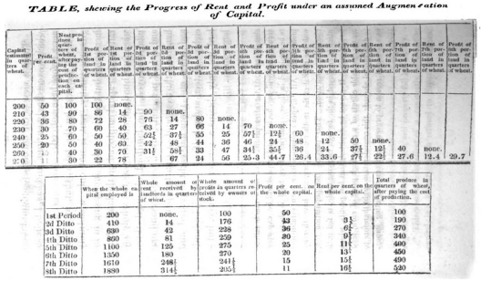
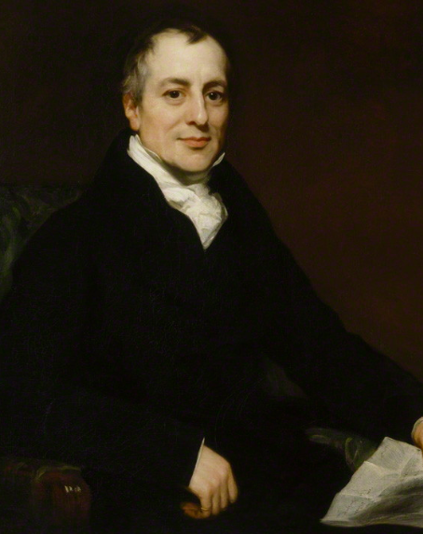
David Ricardo
(1772 –1823) First ever rigorous economist. No graphs, no calculus, just painstakingly arranged numerical examples, but with a clear analysis. Ricardo’s 1815 essay was the first correct published account of differential rent, along with incredibly insightful remarks on trade, growth, tax incidence, banking, in fewer than 11000 words.
An Essay on the Influence of a low Price of Corn on the Profits of Stock; shewing the Inexpediency of Restrictions on Importation: With Remarks on Mr Malthus' Two Last Publications: "An Inquiry into the Nature and Progress of Rent;" and "The Grounds of an Opinion on the Policy of restricting the Importation of Foreign Corn" By David Ricardo, Esq. London: Printed for John Murray, Albemarle Street, 1815
Ricardo's insight was that rent arises because some land is better than other land. As population grows and demand for food increases, cultivation must extend to increasingly less fertile land. The price of corn must then rise sufficiently to make production on this inferior "marginal" land worthwhile. The cost differential creates a producer surplus, which landlords capture in the form of land rent.
"corn is not high because a rent is paid, but rent is paid because corn is high"
https://commons.wikimedia.org/wiki/File:Portrait_of_David_Ricardo_by_Thomas_Phillips.jpg
TUE ch 1: A prime café location commands a high rent precisely because customers are willing to pay high prices and generate high revenues there. The profitability of the activity creates the rent, not vice versa.

Slide 19
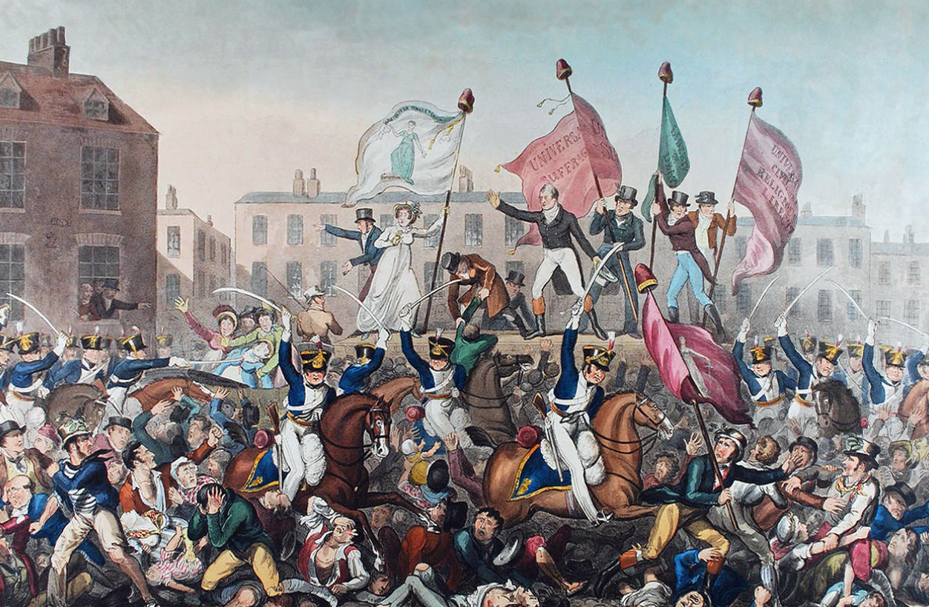
David Ricardo and the original Reform UK (1815-1848)
1815: Waterloo, end of the Napoleonic Wars.
Beginning of the Post-Napoleonic Depression.
Corn Laws: high tariffs on grain imports.
An Essay on the Influence of a low Price of Corn…
1819: Peterloo massacre: violent suppression of a peaceful protest for parliamentary reform ~60,000 in St. Peter’s Field, Manchester, ~700 killed or injured.
1819: Ricardo enters Parliament, advocating
for political reform and for free trade,
particularly repealing the Corn Laws.
1823: Ricardo dies.
1832: Reform Act (extending political franchise)
1846: Corn Laws repealed
1848: Revolutions in Europe except Britain.
https://en.wikipedia.org/wiki/Peterloo_Massacre#/media/File:Peterloo_Massacre.png

Slide 20
David Ricardo and the original Reform UK (1815-1848)
This exercise reformulates the first rigorous model ever used in Economics: David Ricardo's 1815 pamphlet An Essay on the Influence of a Low Price of Corn on the Profits of Stock, later developed in his magnum opus On the Principles of Political Economy and Taxation (1817). Ricardo did not have access to graphs, he presented his ideas through numerical examples, but all the key elements in this exercise were present in Ricardo's essay: differential rent, population growth, marginal land, international trade, and redistribution.
Ricardo's fundamental insight “corn is not high because a rent is paid, but rent is paid because corn is high” is arguably the most profound result of classical economics.
Ricardo's work and life was intertwined with the two foremost questions of his time: political reform and free trade. At the end of the Napoleonic Wars, the land-owning aristocracy was largely over-represented in Parliament, as the result of an extremely restrictive franchise (fewer than 1% of the population had voting rights) and an archaic electoral map, such as the uninhabited hill of Old Sarum in Wiltshire electing two MPs, while Manchester, Birmingham, Leeds, Sheffield all had zero. In turn, the aristocracy-dominated Parliament passed controversial legislation such as the Corn Laws (1815) establishing high tariffs on grain imports.
Ricardo was concerned about a structural problem: as population grew and food demand rose, poorer and poorer land had to be brought into cultivation. This raised the price of corn, increased land rents, reducing the share of surplus available for investment and industrial expansion, and threatening both economic development and social stability.
Ricardo purchased a Parliament seat in 1819 and joined the liberal reformers, who sought to redistribute both political power and economic surplus. By enlarging the franchise and breaking the grip of the landed elite, they hoped eventually to pass laws that would lower food prices, reduce land rents, and support industrial expansion. Ricardo died in 1823, aged just 51, too soon to witness the success of reformist campaigns over the following 25 years: in 1832, the Reform Act abolished many rotten boroughs and extended the franchise to the male urban middle class. In 1846, the Corn Laws were repealed, and Britain began a policy of free trade that lasted until the 1930s.
Read more in Tim Harford's chapter "Who Pays For Your Coffee" from The Undercover Economist.

Slide 22
B1: free trade
aggregate supply, the import supply curve is horizontally summed with domestic supply.
Find the B1 equilibrium consumption B1c by intersecting demand and aggregate supply. Then read domestic production on the domestic supply curve at B1p.
B1 is an efficient allocation, by the FTWE

Slide 23
B3 is a tariff of 62 per imported unit.
To construct aggregate supply, the import supply curve is shifted vertically up by 62, and then horizontally summed with domestic supply.
Find the B3 equilibrium consumption B3c by intersecting aggregate demand and aggregate supply. Then read domestic production on the domestic supply curve.

Slide 24
B3 is a tariff of 62 per imported unit.
Government tariff revenue is 62 x 1949 = 121647.
PS, CS, and government surplus (=revenue from the tariff) can be represented as areas.
DWL: missing total area relative to the total surplus in the efficient (B1) equilibrium. A deadweight loss always corresponds to a shortfall in total surplus relative to an efficient allocation.
2 methods to compute and interpret DWL:
Surplus accounting (using tables of surpluses and hypothetical transfers)
Unit-by-unit analysis (using graph and curves). Let’s compute DWL(B3)

Slide 25
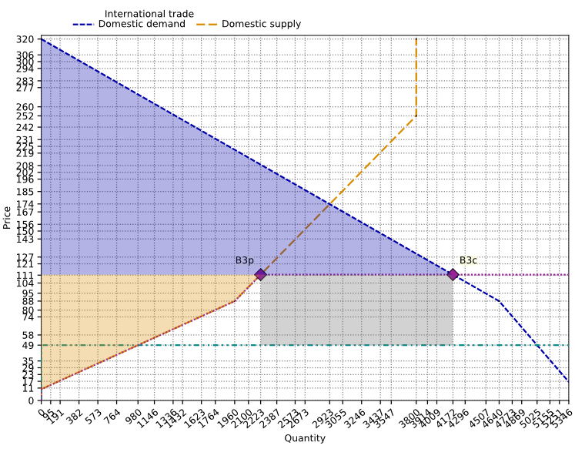
Areas
There are often multiple ways to represent surpluses graphically. For example, tariff revenue is 62 x 1949 = 121647

Slide 26
DWL via surplus accounting
In B3, total welfare is 682119, while in B1, total welfare is 745816.
The deadweight loss of B3 is the shortfall: 745816 - 682119 = 63697.
Winners’ gain from B1 -> B3:
the government collects 121647 revenue,
domestic producers are better off by 125424 - 19110 = 106314,
the total gain is 121647 + 106314 = 227961.
Losers’ loss from B1 -> B3:
consumer surplus down by: 726706 - 435048 = 291658.
Collectively, consumers would be willing to transfer
121647 to the government and
106314 to domestic producers
in return for staying in B1 rather than imposing B3,
Consumers would still have 726706 - 121647 - 106314 = 498745 left, which is better than B3 CS by 63697 .
Hence the DWL 63697 corresponds to losses not matched by a corresponding gain by another economic agent.
Definition of DWL: Shortfall in total welfare relative to an efficient allocation
Pigouvian (if externalities)
competitive eqm (it FTWE applies)
Add up surpluses of all parties:
Consumers
Producers
Government
Victim/beneficiaries of externalities
No re-weighting: every surplus counts as 1

Slide 27
DWL via unit-by-unit analysis
Units q=980 through q=2223 are produced domestically even though importing would cost less.
Inefficient insourcing DWLp = 32436 .
Units q=4172 through q=5025 are valued by consumers above their cost, but they are not consumed because the tariff raises the domestic price.
Underconsumption DWLc = 31261 .
Total DWL: 32436 + 31261 = 63697
Start with changes in allocation w.r.t. B1
Which method to use?
Unit-by-unit analysis is better for understanding allocation of resources, to distinguish DWLc and DWLp, it involves fewer computations, and it maps better into areas on a graph.
Surplus accounting is better for political economy analysis, it lets you define a group’s willingness to pay to block (or to enact) a policy change, and it is quicker if you have already computed PS, CS, GS.
DWLp
DWLc

Slide 28
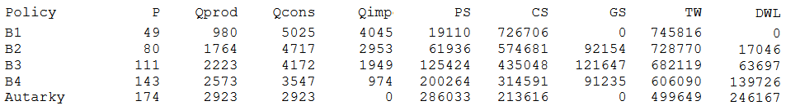
What is the impact of the tariff rate on various outcomes?
Equilibrium
Surplus of different agents
Government revenue
Deadweight loss
Who “pays” the tariff?

Slide 29
What is the impact of the tariff rate on various outcomes?
Equilibrium
Surplus of different agents
Government revenue
Deadweight loss
Who “pays” the tariff?

Slide 30
What is the impact of the tariff rate on various outcomes?
Equilibrium
Surplus of different agents
Government revenue
Deadweight loss
Who “pays” the tariff?

Slide 31
What is the impact of the tariff rate on various outcomes?
Equilibrium
Surplus of different agents
Government revenue
Deadweight loss
Who “pays” the tariff?

Slide 32
What is the impact of the tariff rate on various outcomes?
Equilibrium
Surplus of different agents
Government revenue
Deadweight loss
Who “pays” the tariff?

Slide 33
Increasing the tariff rate B1 < B2 < B3 < B4
Increases the eqm price
increases PS,
decreases CS,
Increases DWL
Increases GS up to B3, then decreases GS
The incidence of the tariff is entirely on consumers

Slide 34
Optimal taxation: varying the tariff rate
This figure generalises the B1 – B4 comparison. In optimal taxation, we are typically interested in GS vs DWL.
B1 performs best on efficiency (DWL =0) => The only way to have full efficiency is not to tax at all
Tax revenue is increasing with the tariff rate up to B3 (t=62), then decreasing => a tariff Laffer curve
The revenue-maximising tariff rate is NOT optimal. Compare tariff rates 50 vs 62: the last 5K of government revenue come at the cost of ~ 20K additional DWL.
B3 would only be optimal for an extractive government that cares only about revenue and not at all about welfare.
The right-hand-side of the Laffer curve is not optimal: the government could reduce the tariff rate, increase revenue and increase TW
B1
B2
B3
B4
Autarky
Notes:
https://iea.org.uk/wp-content/uploads/IEA_The-Laffer-Curve-in-Action_V3_Digital.pdf
econlib.org/library/Columns/y2017/Morongnoise.html

Slide 35
Tariffs-Quota equivalency: B3 & B5

Slide 36
Tariffs-Quota equivalency: B3 & B5

Slide 37
Tariffs-Quota equivalency: B3 & B5
The key remark is that policies B3 and B5 lead to the same: price, production, consumption,
=> same CS and PS, same TW, DWL
only difference: GS(B3) = IS(B5)
GS(B3) = 62 tariff on 1949 units imported
IS(B3) = 1949 units bought @ 49 and sold @ 111
Generally, a tariff leading to importing Qi is equivalent to a quota Qi, and a quota leading to a price of P is equivalent to a tariff t = P-W, where W=world price.

Slide 38
Exact static equivalency via auctioning quotas: B3 & B6
An exact static equivalency: B3 & B6
Rather than handing over the 1949 licences for free, the government auctions them off to would-be importers. Assume a perfectly efficient auction, with many identical bidders, so each bidder bids exactly their willingness-to-pay.
Willingness-to-pay is the expected profit from owning one licence, i.e. domestic price minus world price: 62. Government auction revenue is 121647, and importer net profit is 0.
The allocation is the same in B5 and B6, but the auction enables the government to capture the entire surplus of importers.

Slide 39
Choosing between quota levels
Due to static equivalency, all statements about incidence and optimality about tariffs also apply to quotas.
Quotas and tariffs are different dynamically: issuing additional quotas enables a government to partially expropriate licence holders
  the quota policy is time-inconsistent
A government lowering the tariff rate would only reduce its revenue
  the tariff policy is time-consistent
"You can fool all the people some of the time, and some of the people all the time, but you cannot fool all the people all the time": if traders anticipate future licence dilution, they will bid less in B6. The government cannot generally capture the full quota rent in the first auction without a credible commitment not to issue further licences.

Slide 40
B8: consumption tax
B8: no tariff, but a consumption tax of 25 per unit.
Aggregate supply: shift both domestic and foreign supply curves vertically by the unit tax 25.

Slide 41
B8: consumption tax equilibrium
B8: no tariff, but a consumption tax of 25 per unit.
Aggregate supply: shift both domestic and foreign supply curves vertically by the unit tax 25.
Since we shift the supply curves, the price found is a buyer price.
The seller price is P-25 = 49.

Slide 42
B8: consumption tax equilibrium & surplus
GS = 25 * 4773 = 119325,
So not quite = 121647 (rounding errors)

Slide 43
Choosing the consumption tax rate

Slide 44
Comparisons B3, B8, B9
B8 raises the same GS as B3, with less DWL
B9 raises more GS than B3, with less DWL,
In fact you can see DWL(B9) = DWLc(B3)
A consumption tax is more effective:
raising revenue while creating less DWL,
relative to a tariff.

